Slide 1
Crux Lecture -17
Data Structures -6
BST
Notes:
File Handling
Linked list code

Slide 2
Binary Search Trees
Notes:
Make them create one file from next time

Slide 3
BST Properties
Every Node in left subtree has value less than or equal to root
Every Node in right subtree has value greater than root
Notes:
Talk about circular linked list

Slide 4
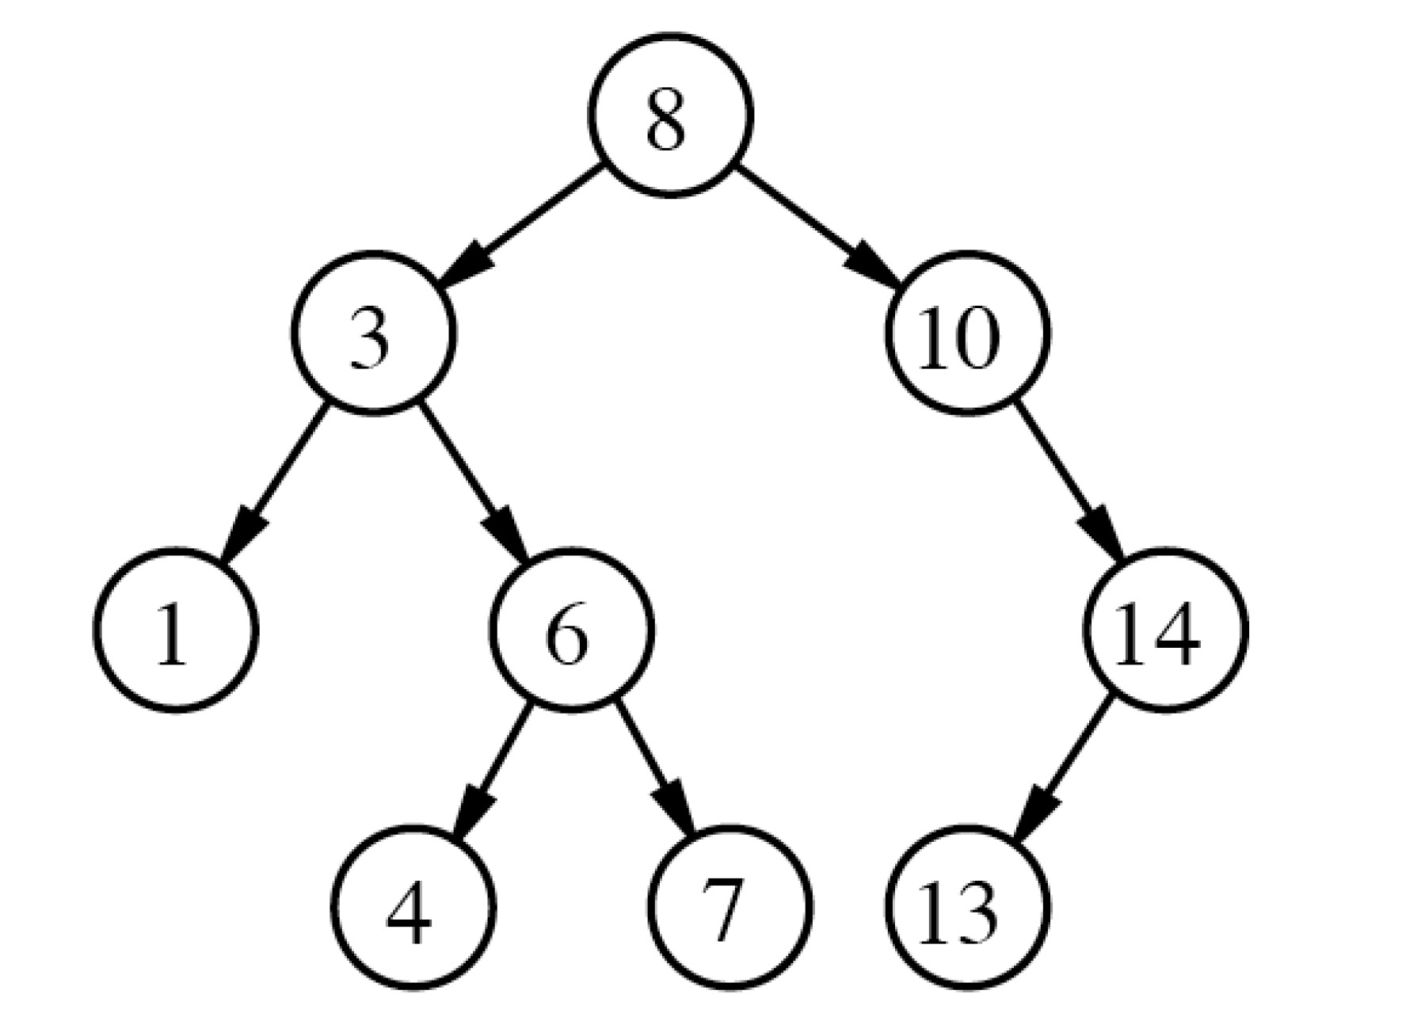
Binary Search trees
Notes:
Talk about circular linked list

Slide 5
Binary Search Trees
class BinarySearchTree{
// accessor methods
int size();
boolean isEmpty(); void addElement(Object element); void removeElement(Object element) throws BSTEmptyException;
}
Notes:
Talk about circular linked list

Slide 6
Your Turn
Given a binary tree check if its BST
Notes:
Talk about circular linked list

Slide 7
Build a BST using a sorted array
Notes:
Make them create one file from next time

Slide 8

Thank You!
Rishab Kapoor
Rishab.Kapoor.29@gmail.com

